Slide 1
Publish – Subscribe folosind RabbitMQ + MassTransit
Baba Tudor

Slide 2
Publish - Subscribe
Subscriber 1
Publisher 1
Pub/Sub Broker
Mesaj 1
Topic 1
Subscriber 2
Mesaj 2
Publisher 2
Topic 2
Mesaj 3
Subscriber 3

Slide 3
Publish-Subscribe folosit RabbitMQ.Client
https://www.rabbitmq.com/tutorials/tutorial-three-dotnet.html

Slide 4
Publish-Subscribe folosit Masstransit
https://masstransit-project.com/
https://masstransit-project.com/MassTransit/quickstart.html
https://masstransit-project.com/MassTransit/usage/message-consumers.html
Live coding ;)

Slide 5
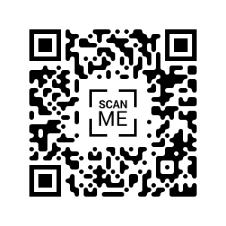
Feedback

